Slide 1
Operating system Definition parts Types Embedded System Definition Why are these so popular Usage in various fields Embedded Operating System Definition Why only this?

Slide 2
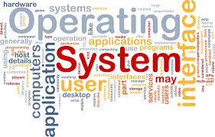

Slide 3
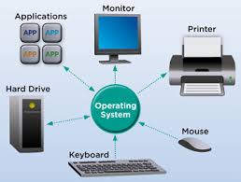
What regular people see Operating system as

Slide 4
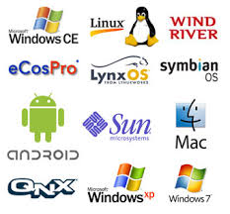
What non-computer employees think

Slide 5
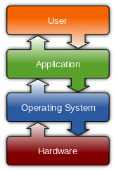
Operating system:
An operating system (OS) is system software that manages computer hardware and software resources and provides common Services for computer programs. All computer programs, excluding firmware, require an operating system to function.

Slide 6
Operating system:
Kernel
01
Device Drivers
02
User Interface
03
System Utilities
04

Slide 7
Kernel
This has the task of loading the applications into memory, making sure they do not interfere with one another and allowing them to share use of the CPU efficiently. The kernel also handles file storage to and from secondary storage devices such as hard disks and optical drives.
In other words the kernel handles:
Loading / Unloading applications from memory
Scheduling tasks to run on the CPU
Memory management
File management
Data security
The single user, single application operating system does not have to deal with networking, unlike the network operating system, on the other hand, a device such as a mobile phone will have to have an extremely efficient memory management kernel as its memory is a very limited resource. So the Kernel of each type of operating system will have been designed with different duties in mind.

Slide 8
Device Drivers
Every piece of hardware that makes up the computer or connected to it, will have a device driver that allows the operating system to control and communicate with it. There could be hundreds of device drivers pre-installed with the operating system, and the right ones for that particular computer set-up is loaded on boot-up.
The exact detail of which device driver is needed by the operating system is kept in a file - in Windows, the file is called the 'registry' and in Linux the details will be stored as a number of 'configuration files'.
Makers of printers, graphics tablets, scanners, digital cameras and so on, will normally provide device drivers for each make of operating system. A device driver for Windows is different from the device driver for Linux.
This is why if you remove an operating system such as Windows from a hard disk, and install Linux instead, you will need to make sure you have all the correct device drivers available for each piece of hardware.

Slide 9
User interface
This part of the operating system is directing what you see on the screen (via the device driver) and reacting to your key presses and other inputs. The user interface could be a basic command line interface, as you might find on a server, or it might be a full blown Graphical User Interface (GUI) such as the Mac OS X, Windows or perhaps Gnome on Linux.

Slide 10
System Utilities
This part of the operating system provides all the basic facilities that run in the background without user interaction. For example,
Print spool services
Cryptographic password management.
File management services

Slide 11
How does the operating system works?
Your computer's operating system (OS) manages all of the software and hardware on the computer. Most of the time, there are several different computer programs running at the same time, and they all need to access your computer's central processing unit (CPU), memory, and storage.

Slide 12
Types of Operating systems
Single & Multi-tasking
Single and Multi-user
Distributed
Templated
Embedded
Real-time
Library

Slide 13
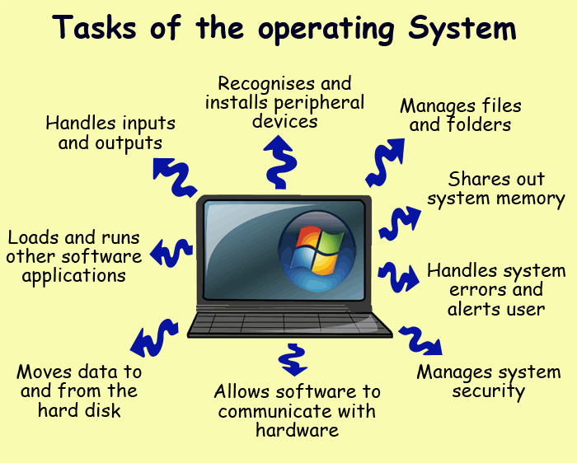
What are the two main functions of an operating system?
An operating system has three main functions:
Manage the computer's resources, such as the central processing unit, memory, disk drives, and printers
Establish a user interface and
Execute and provide services for applications software.

Slide 14
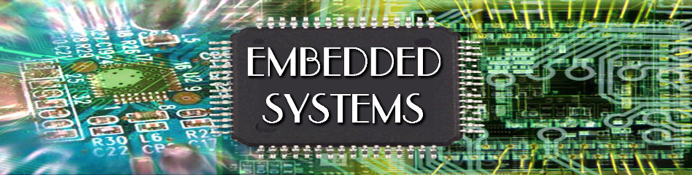

Slide 15
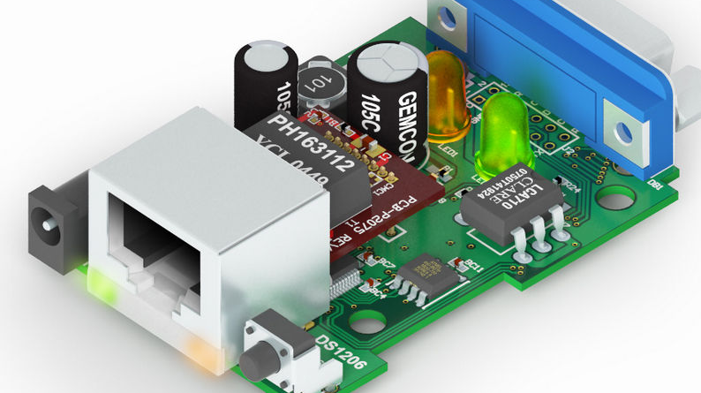
Why are we choosing embedded…?
The word itself means within.
These operating systems are designed to be compact, efficient at resource usage, and reliable, forsaking many functions that non-embedded computer operating systems provide, and which may not be used by the specialized applications they run.
The uses of embedded systems are virtually limitless, because every day new products are introduced to the market that utilize embedded computers in many ways.

Slide 16
Embedded System:
What is embedded system
How does it look like
What are the benefits of using it?
Which fields use embedded?
What is its importance?

Slide 17
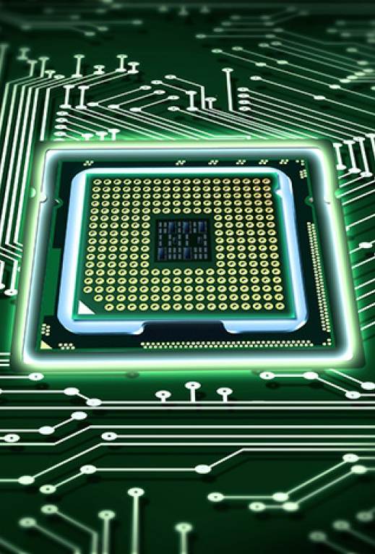
Embedded System:
An embedded system is some combination of computer hardware and software, either fixed in capability or programmable, that is designed for a specific function or for specific functions within a larger system.

Slide 18
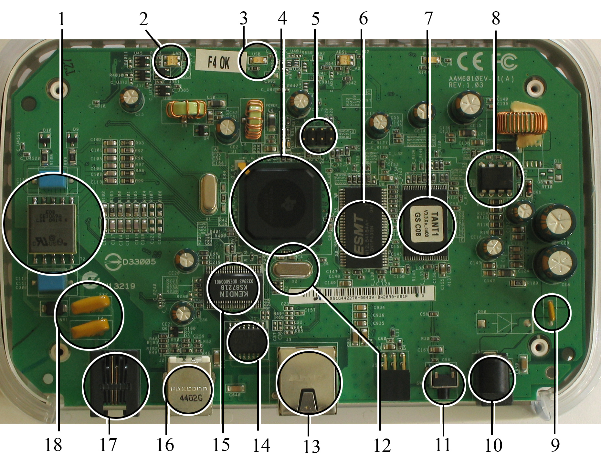
Some parts …
Microprocessor (4)
RAM (6)
Flash memory (7)

Slide 19
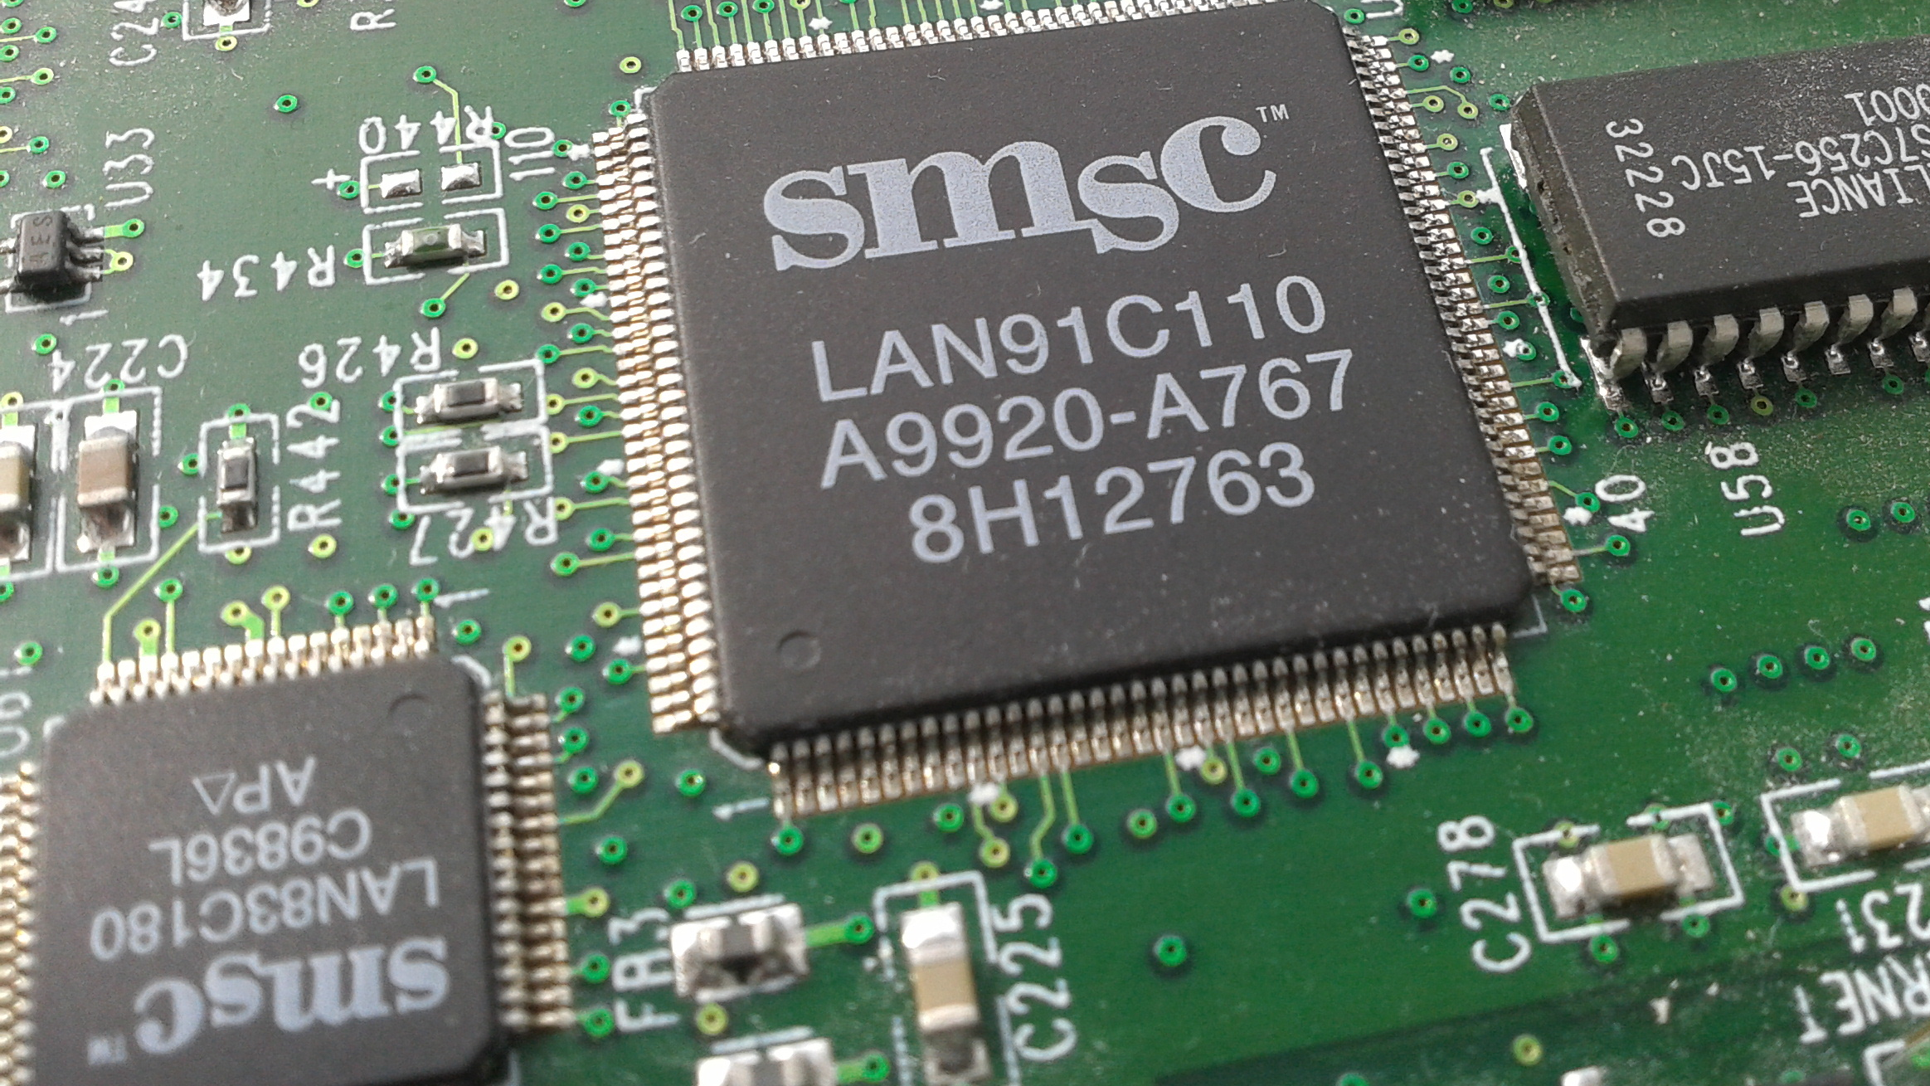
Peripherals:
Embedded systems talk with the outside world via peripherals, such as:
Serial Communication Interfaces (SCI): RS-232, RS-422, RS-485, etc.
Synchronous Serial Communication Interface: I2C, SPI, SSC and ESSI (Enhanced Synchronous Serial Interface)
Universal Serial Bus (USB)
Multi Media Cards (SD cards, Compact Flash, etc.)
Networks: Ethernet, LonWorks, etc.
Fieldbuses: CAN-Bus, LIN-Bus, PROFIBUS, etc.
Timers: PLL(s), Capture/Compare and Time Processing Units
Discrete IO: aka General Purpose Input/Output (GPIO)
Analog to Digital/Digital to Analog (ADC/DAC)
Debugging: JTAG, ISP, ICSP, BDM Port, BITP, and DB9 ports.

Slide 20
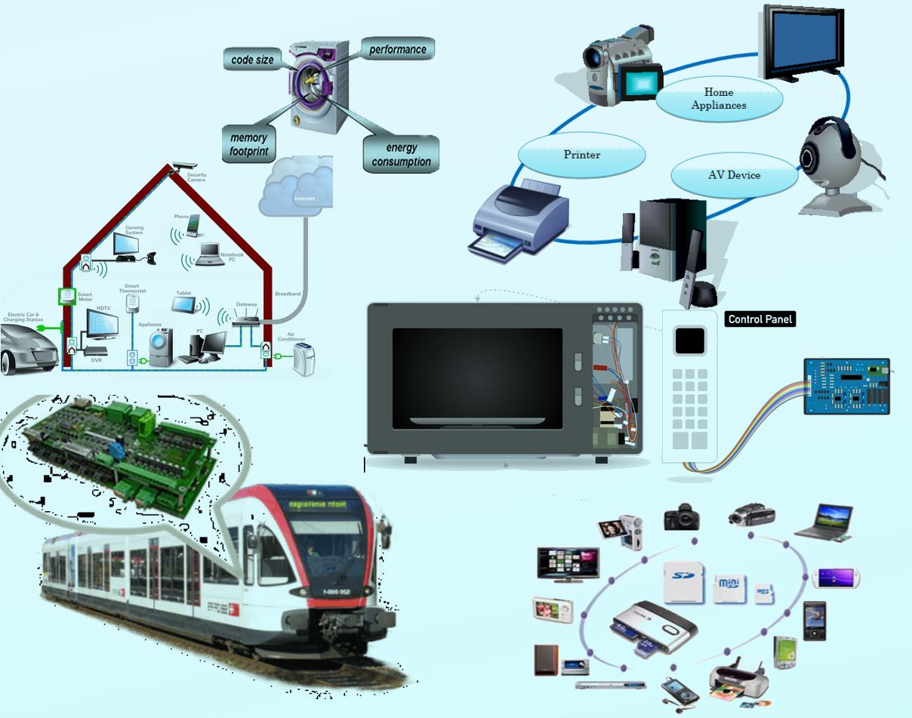
Applications:
A software application that permanently resides in an industrial or consumer device. Providing some type of control function and/or user interface, the software is typically stored in a non-volatile memory such as ROM or flash memory.

Slide 21
Applications:

Slide 22
Embedded Software Architectures:
Simple Control Loop
Interrupt-controlled System
Cooperative Multitasking
Preemptive multitasking or multi-threading
Microkernels and exokernels
Monolithic kernels

Slide 23
What is an embedded system programming?
Embedded programming is a specific type of programming that supports the creation of consumer facing or business facing devices that don't operate on traditional operating systems the way that full-scale laptop computers and mobile devices do.

Slide 24
Embedded Operating System
An embedded operating system is an operating system for embedded computer systems. These operating systems are designed to be compact, efficient at resource usage, and reliable, forsaking many functions that non-embedded computer operating systems provide, and which may not be used by the specialized applications they run. They are frequently also referred to as real-time operating systems, and the term RTOS is often used as a synonym for embedded operating system.

Slide 25
Difference B/W embedded OS & Desktop OS:
An important difference between most embedded operating systems and desktop operating systems is that the application, including the operating system, is usually statically linked together into a single executable image.
Unlike a desktop operating system, the embedded operating system does not load and execute applications. This means that the system is only able to run a single application.

